Slide 1
NONMEM Diagnostics 1 – Single Run Based
배 균 섭
임상약리학과

Slide 2
Single Run Based Dx
S1. OFV & Minimization Process
S2. Theta, Omega, Sigma
S3. Prediction (Fitted) Values
S4. Residuals Related
S5. EBE Related
SA. Input Data
SB. Standard Output
SC. Individual Parameters

Slide 3
S1-Minimization related
OFV (MVOF)
OFV per DV and its distribution
AICc
SBC
Large gradient
Vech(M) = c(M[upper.tri(M, diag=T)])

Slide 4
S2-Parameters related Theta, Omega, Sigma
Theta
PE, SE, LL, UL, mean=0, mean=1
Omega
PE, Variance-Covariance matrix
Square root of diagonal elements
Exponential eta model: CV of individual PK/PD Parameters
SE and RSE
Sigma
Same with Omega in principle
Usually fixed as 1

Slide 5
S3 – Prediction related
DV vs. PRED (Typical prediction, prediction using typical values of structural model parameters, eta=0)
DV vs. IPRE (Individual prediction using EBE)
All subjects' superposed [DV, PRED, IPRE] vs. Time after dose (TAD) in original scale
All subjects' superposed [DV, PRED, IPRE] vs. Time after dose (TAD) in log scale of Y
Individual plot of 3), 4)

Slide 6
S4-Residual related (1)
All subjects' superposed WRES vs. [PRED, TAD]
All subjects' superposed CWRES vs. [IPRE, TAD]
All subjects' superposed IWRES vs. [IPRE, TAD]
Absolute y values of 1), 2), 3)
Distribution statistics of [WRES, CWRES, IWRES] : histogram, density plot, Q-Q plot, Shapiro-Wilk test, SD of residual

Slide 7
S4-Residual related (2)
Test and CI of residual counts using binomial distribution
Ratio of [WRES, CWRES, IWRE] count to expected count
Residuals with extreme z values
Individual residual plot of 1), 2), 3)
Run test results of 9)

Slide 8
S5-EBE related (1)
Descriptive statistics of Etas: minimum, 1Q, median, mean, 3Q, maximum, SD
T-test with H0: mean is zero.
Shapiro-Wilk test on normality
Etas' population shrinkage
SE of EBE, Individual Eta Shrinkage
Histogram, density plot, Q-Q plot

Slide 9
S5-EBE related (2)
Plot of etas vs. continuous covariates: histogram, trend plot
Plot of etas vs. categorical covariates
Omega estimation vs. variance-covariance/correlation/SD of EBEs
Ratio of Omega to Sample Variance-Covariance Matrix of EBEs : Replacement of eta population shrinkage
Those of correlation matrices
Multiple linear regression (MLR) of EBEs using covariates as independent variables

Slide 10
Example of Control File
$INFN
IF (ICALL.EQ.3) THEN
CLOSE (56)
WRITE (51,*) OBJECT
WRITE (52,*) THETA
WRITE (52,*) SETHET
WRITE (53,*) OMEGA(BLOCK)
WRITE (53,*) SEOMEG(BLOCK)
WRITE (54,*) SIGMA(BLOCK)
WRITE (54,*) SESIGM(BLOCK)
WRITE (55,*) IIDX, CNTID
CLOSE (55)
ENDIF

Slide 11
Getting SE of EBE (NMVI only)
$ERROR
"FIRST
" INCLUDE 'C:/NMVI/SIZES'
" COMMON /ROCM36/ POSTV(LVR,LVR)
" DOUBLE PRECISION POSTV, PPSTV1
" INTEGER PREVID, CVRSTEP
…
…
"IF (PPSTV1.NE.POSTV(1,1)) THEN
" IF (PREVID.EQ.NIREC) THEN
" CVRSTEP = 1
" ELSEIF (CVRSTEP.EQ.1) THEN
" WRITE (56,*) PREVID, (SQRT(POSTV(J_,J_)), J_=1,NETAS_)
" ENDIF
" PPSTV1 = POSTV(1,1)
" PREVID = NIREC
"ENDIF

Slide 12
$EST MAXEVAL=9999 PRINT=1 METHOD=COND INTER MSFO=THIS.MSF NOABORT NOTBT NOOBT NOSBT
$COV PRINT=ERS
$TAB ID TIME MDV IPRE IWRE
G11 G21 G31 H11
FILE=sdtab NOPRINT ONEHEADER
$TAB ID V CL KA K ETA(1) ETA(2) ETA(3)
FILE=patab NOPRINT ONEHEADER NOAPPEND
$TAB ID WT
FILE=cotab NOPRINT ONEHEADER NOAPPEND
$TAB ID
FILE=catab NOPRINT ONEHEADER NOAPPEND
$TAB ID WT
ETA(1) ETA(2) ETA(3)
FILE=COVARETA NOPRINT ONEHEADER NOAPPEND FIRSTONLY
$TAB ID CL K V KA
FILE=INDIPARA NOPRINT ONEHEADER NOAPPEND FIRSTONLY

Slide 13
Run test coding (1)
run.p <- function(m, n, r)
{
# INPUT
# m : count of fewer species (minimum value = 0)
# n : count of more frequent species (minimum value = 1)
# r : count of run (minimum value = 1)
# RETURNS probability of run count to be less than or equal to r with m and n
# P(Run count <= r | m, n)
If (m==0 & r==1)
{ return(1) }
else if (m>n | m<1 | n<1 | r<2 | (r>min(m+n, 2*m+1)))
{ return(0) }

Slide 14
Run test coding (2)
sumfu <- 0
for (u in 2:r) {
if (u %% 2 == 0) {
k = u / 2
fu <- 2 * choose(m-1, k-1) * choose(n-1, k-1)
} else {
k = (u + 1) / 2
fu <- choose(m-1, k-1) * choose(n-1, k-2) + choose(m-1, k-2) * choose(n-1, k-1)
}
sumfu <- sumfu + fu
}
return(sumfu / choose(m+n, m))
}

Slide 15
Run test for Residuals
run.test.nm <- function(RES)
{ t <- length(RES)
r <- RES >= 0 # zero as positive
m <- sum(r)
if (t > 1) { j <- 2:t
run <- sum(abs(r[j] - r[j-1])) + 1
} else { run <- 1 }
m <- min(m, t-m)
n <- max(m, t-m)
if (run > 1) { p <- run.p(m, n, run)
if (p > 0.5) p <- 1 - run.p(m, n, run-1)
} else { p <- 0.5^(t-1) }
return(p)
}

Slide 16
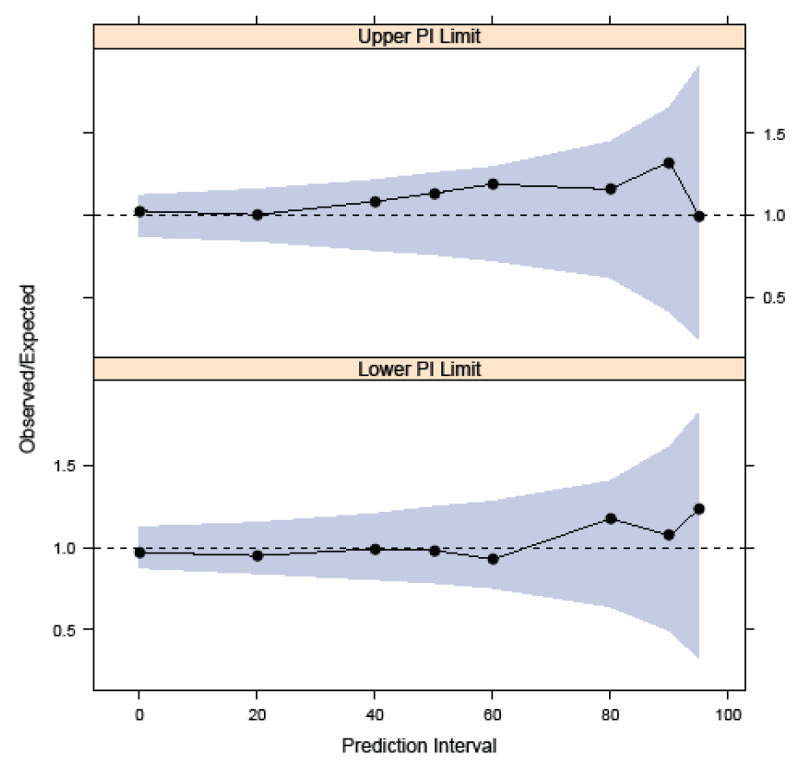
Coverage plot by PsN NPC

Slide 17
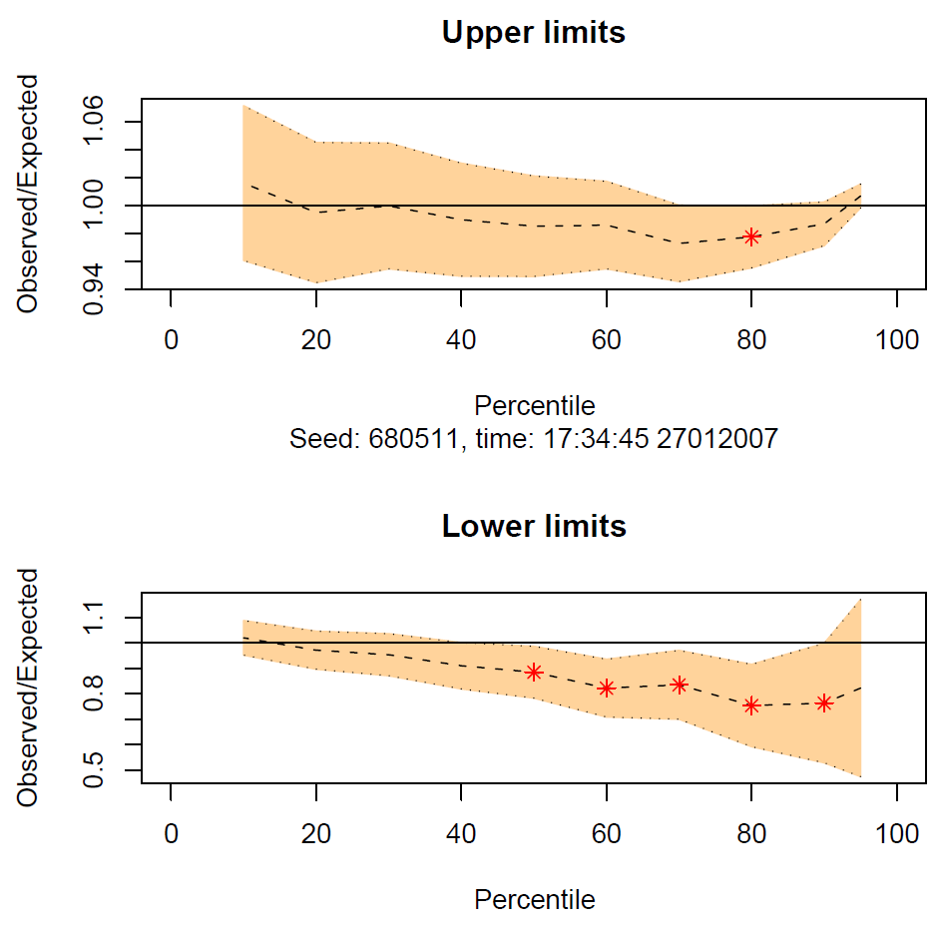
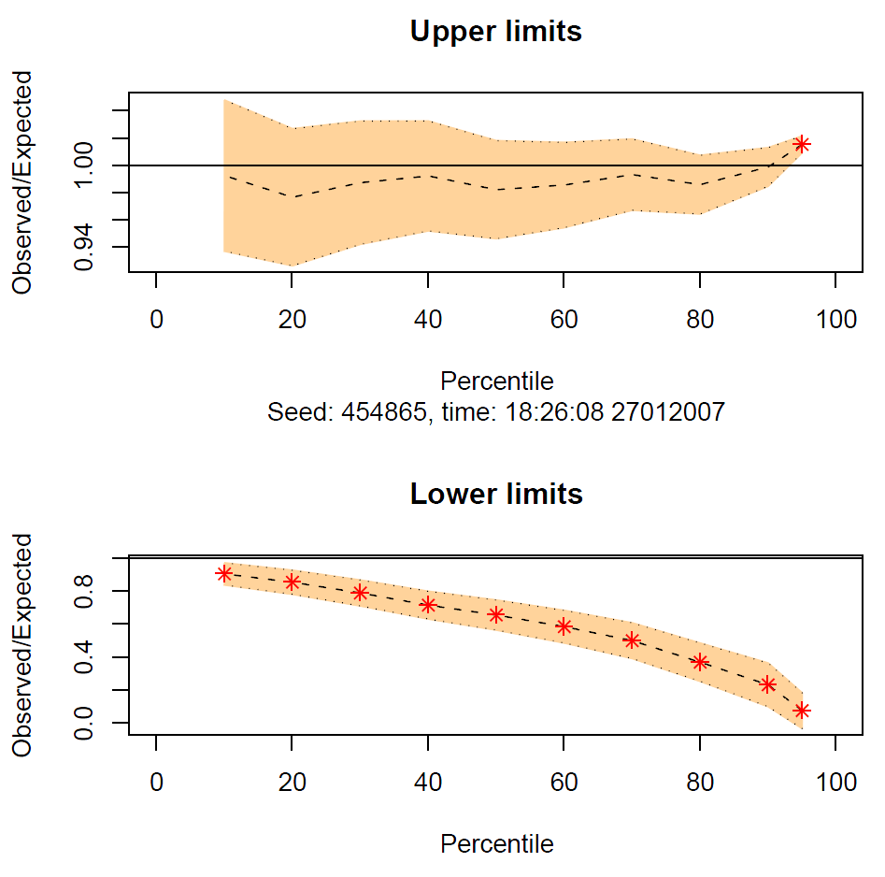
NPC Coverage Plot (Old)

